Slide 1


K.S.R.M. COLLEGE OF ENGINEERING (UGC-AUTONOMOUS) Kadapa, Andhra Pradesh, India– 516 003 Approved by AICTE, New Delhi & Affiliated to JNTUA, Ananthapuramu. An ISO 14001:2004 & 9001: 2015 Certified Institution
TITLE : Trajectory of Cyclone in Satellite Video using Advanced Machine Learning Techniques
Under The Guidance of
Dr. D. ARUN KUMAR ,Ph.D.
Batch No: A₁₀
Project Associates :
K.S.GOWTHAMI -199Y1A0458
KAYALA JANARDHANA -199Y1A0467
GOLLA PRASANNA KUMAR -199Y1A0448
KALLURI KHAJABEE - 199Y1A0462
Department of Electronics and Communication Engineering
2022-2023

Slide 2
ABSTRACT:
The aim of current project is to get the trajectory of the Cyclone and to predict the point of contact of the Cyclone on the land surface in Satellite Video using Advanced Machine Learning Techniques.

Slide 3
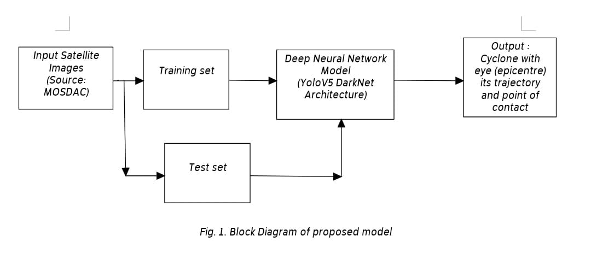
BLOCK DIAGRAM:

Slide 4
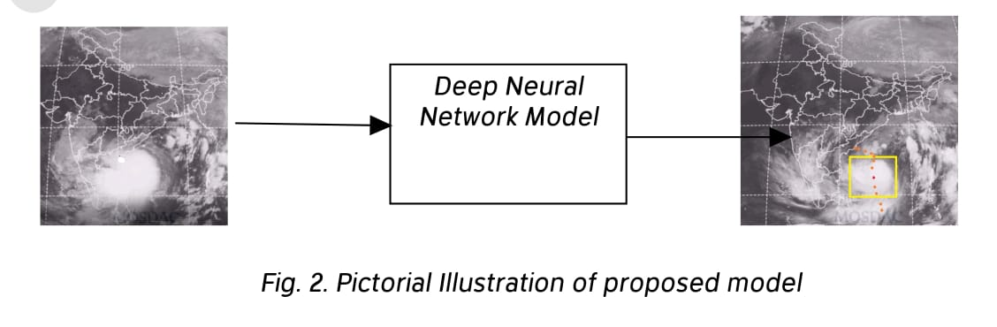
Proposed Model:

Slide 5
OBJECTIVE:
Identifying Cyclone in the Satellite Video.
Getting the epicentre (eye) of the cyclone.
Getting the Trajectory of the cyclone.

Slide 6
Data Source:
MOSDAC
(Meteorological and Oceanographic Satellite Data Archival Centre)
Data Source Link:
https://mosdac.gov.in

Slide 7
Data Description:
S.No | Name of the Cyclone | Duration | Region
1 | Asani | May 7-11,2022 | Bay of Bengal
2 | Jawad | Dec 3-6,2021 | Bay of Bengal
3 | Gulab | Sep 24 - Oct4,2021 | Arabian Sea
4 | Yaas | May 24-27,2021 | Bay of Bengal
5 | Tauktae | May 14-19,2021 | Arabian Sea
6 | Sitrang | Oct 25-29,2022 | Bay of Bengal
7 | Mandous | Dec 7-10,2022 | Bay of Bengal

Slide 8
OBJECTIVE 1 :
Results related to objective 1 are obtained.
Detection of cyclone
Url: https://drive.google.com/file/d/14x7JPc8-r1OqQqTfqL5GMWj8l0WwXD3t/view?usp=share_link

Slide 9
OBJECTIVE 2 :
CURRENT STATUS OF THE PROJECT:
Results related to objective2 are obtained.
Detection of epicenter
URL:https://drive.google.com/file/d/1CycmCTHwJ8IQEz-XyGsfER38rBz-r0xY/view?usp=share_link

Slide 10
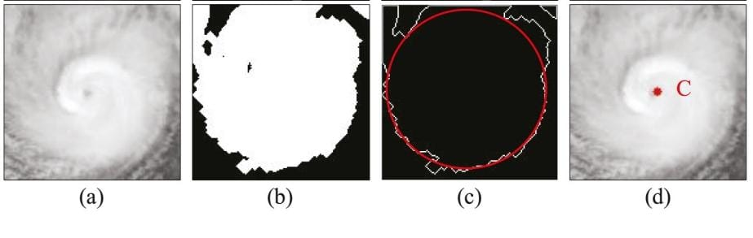
Processing results of image segmentation:
Object Detection
(b) Binary Segmentation
(c) Edge and circle detection
(d) Eye detection based on concentric circles

Slide 11
OBJECTIVE 2 :
Bounding box method :
A bounding box method is being used from the base paper A Center Location Algorithm for Tropical Cyclone in Satellite Infrared Images,(Authors : Ping Ping, Ping Wang, Cong Wang, Yue Yuan, and Di Wang published in the year 2020)

Slide 12
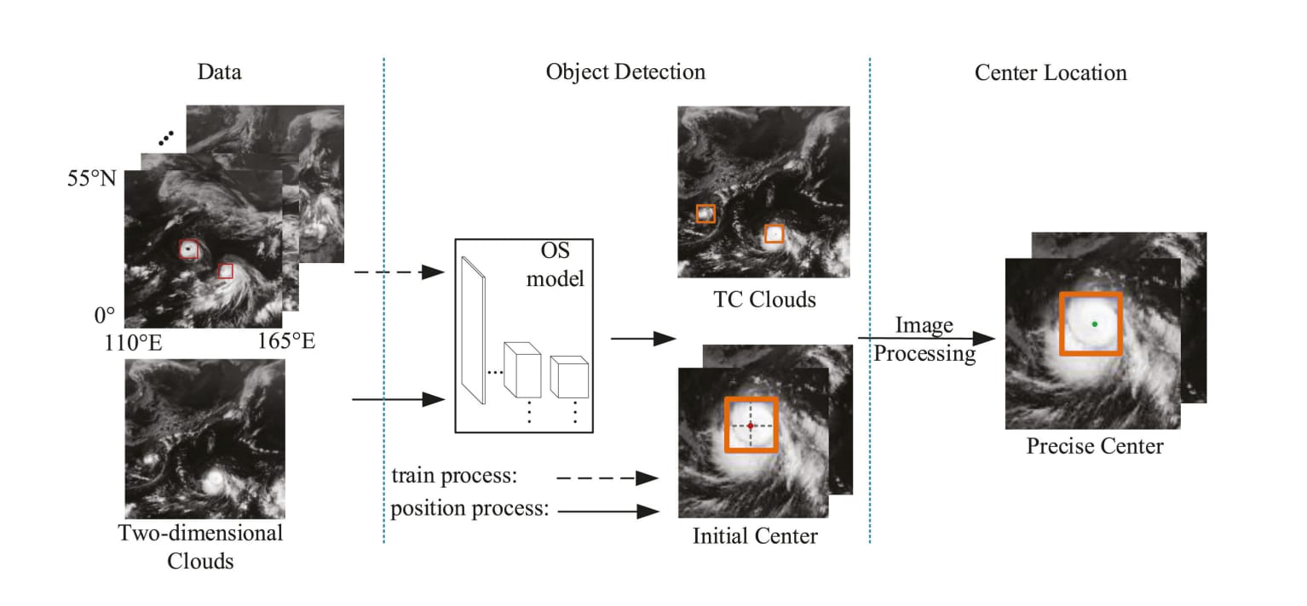
Expected Output:
Fig: Flowchart of the OSIP algorithm

Slide 13
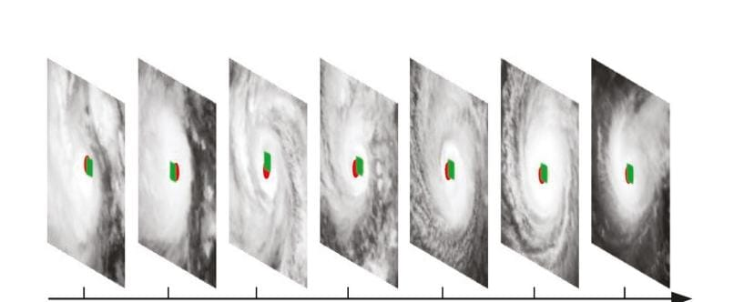
TRAJECTORY OF THE CYCLONE IN THE DIFFERENT IN SATELLITE IMAGE IN DIFFERENT FRAMES: Expected Output:

Slide 14
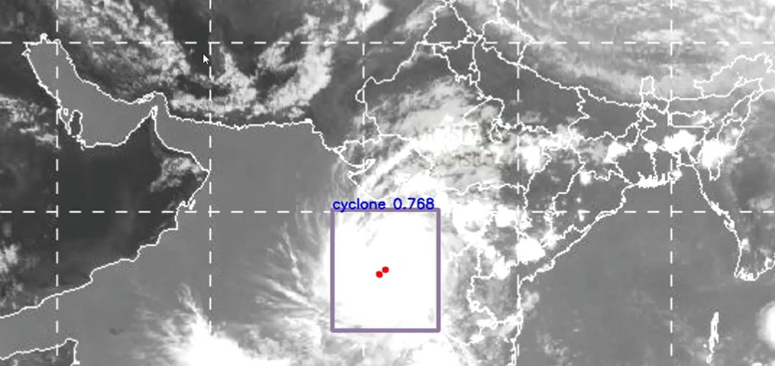
OBJECTIVE 3:
Results related to objective 3 are obtained.
Trajectory of cyclone.

Slide 15
REFERENCES:
Base Paper
W. C. Lin, D. Y. Liao, C. Y. Liu, and Y. Y. Lee, “Daily imaging scheduling of an earth observation satellite,” IEEE Trans. Syst., Man, Cybern . A, Syst Humans, vol. 35, no. 2, pp. 213–223, Mar. 2005.
N.Valizadeheal, “Artificial intelligence and geo-statistical models for stream-flow forecasting in ungauged stations: State of the art,” Natural Hazards, vol. 86, pp. 1377–1392, 2017.

Slide 16
THANK
YOU

